Slide 1

IPL Data Analysis Project Report
Analyzing Indian Premier League (IPL) Data from 2008 to 2020
Rohit Rai

Slide 2
Contents
5. Team Performance Analysis
6. Toss Outcomes Analysis
7. Player Performance Analysis
8. Specific Batsman Analysis
9. Conclusion
1. Introduction
2. Data Collection
(i) Importing Libraries
(ii) Gathering Data Files
(iii) Consolidating Data
3. General Match Statistics
4. Venue and City Analysis

Slide 3
1. Introduction
The Indian Premier League (IPL) is one of the most popular and competitive cricket leagues globally, attracting millions of fans and featuring top-tier talent. This project aims to perform a comprehensive analysis of IPL matches and deliveries data from 2008 to 2020, leveraging data manipulation and visualization techniques to uncover trends, patterns, and factors influencing match outcomes, team performances, and player contributions. By examining match data, team performances, and individual player statistics, we aim to provide valuable insights into the IPL's dynamics.

Slide 4
2. Data Collection
2.1 Importing Libraries
Importing essential libraries like pandas for data manipulation, numpy for numerical operations, matplotlib and seaborn for data visualization, and other relevant libraries is crucial for this analysis.
2.2 Gathering Data Files
The data for IPL matches and deliveries is gathered from CSV files. These files are read into pandas DataFrames for further processing.
2.3 Consolidating Data
The match and delivery data are consolidated into unified DataFrames, enabling comprehensive analysis and manipulation. This step involves merging datasets and ensuring data types are consistent.

Slide 5
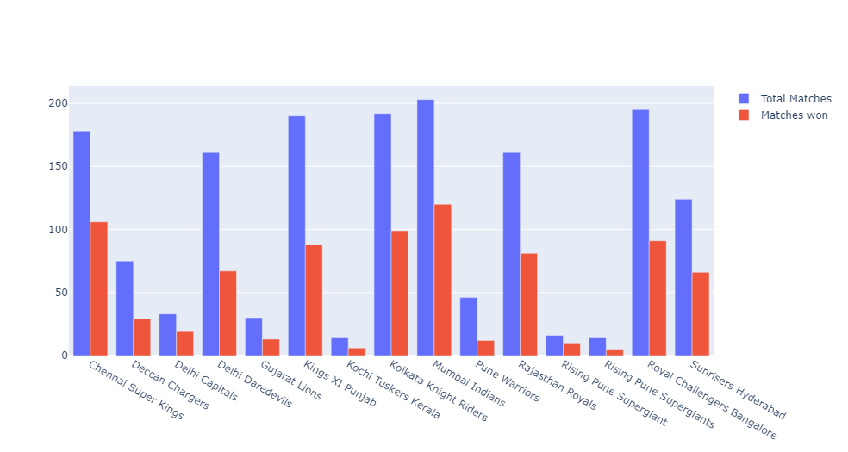
3. General Match Statistics
This section explores the overall match statistics, including total matches played, results distribution, and seasonal trends. Visualizations help in understanding the frequency of different outcomes and the overall growth of the IPL over the years.

Slide 6
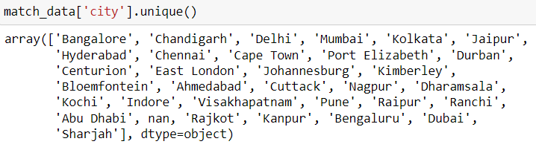
4. Venue and City Analysis
Analyzing the impact of different venues and cities on match outcomes, this section delves into the performance of teams at various locations, identifying any home-ground advantages or trends specific to certain venues.

Slide 7
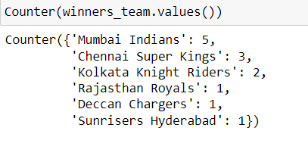
5. Team Performance Analysis
This section focuses on team performances across seasons, identifying the most successful teams, win-loss records, and factors contributing to team success. It also compares team performances in different match situations.

Slide 8
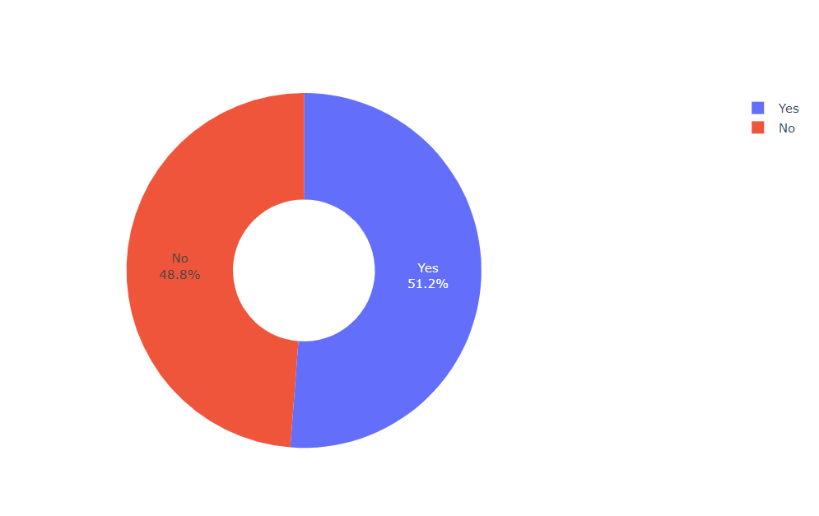
6. Toss Outcomes Analysis
Examining the impact of toss outcomes on match results, this section analyzes the correlation between winning the toss and winning the match. It also looks into teams' decisions to bat or bowl first and their subsequent performance.

Slide 9
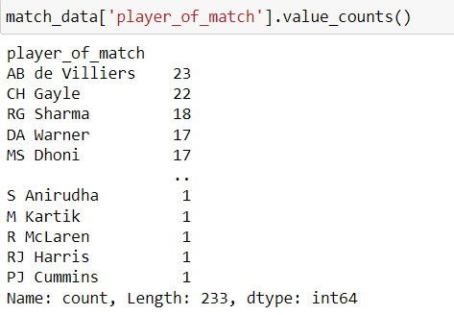
7. Player Performance Analysis
This section highlights the standout players in the IPL, analyzing individual performances in terms of runs scored, wickets taken, and overall impact on matches. It identifies key players and their contributions to their teams' successes.

Slide 10
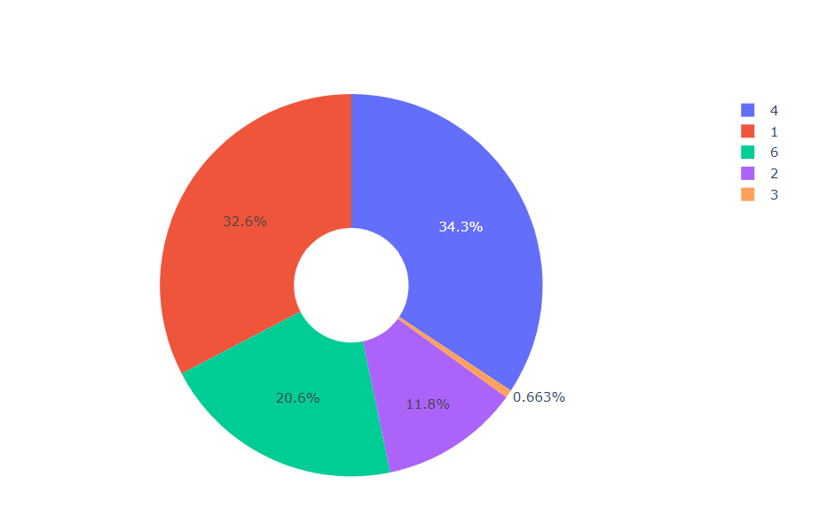
8. Specific Batsman Analysis
Focusing on specific batsmen, such as Virat Kohli, this section provides a detailed view of individual performances, including batting averages, strike rates, and consistency across seasons. Visualizations help in comparing different batsmen and their impact on the game.

Slide 11
9. Conclusion
This project provided an in-depth analysis of the IPL data from 2008 to 2020, revealing significant insights into various aspects of the game. By examining match data, team performances, and individual player statistics, we identified trends and patterns that highlight the dynamic nature of the IPL. The analysis showed which teams have consistently performed well, the impact of winning the toss, and the influence of key players on match outcomes. Visualizations helped in understanding the data better and in identifying trends across different seasons. This comprehensive analysis not only enhances the understanding of the IPL but also serves as a valuable resource for cricket analysts, enthusiasts, and strategists, providing a robust foundation for further research and exploration into the intricacies of one of the world's most popular cricket leagues.

Slide 12
Thank You
Rohit Rai

